Slide 1

MVP 3
Robertas Ašvicas
Dmitry Lvov
The Netherlands, 2020

Slide 2
Current achievements
Separated VPCs for different projects
Peering connection
Configured Route Tables
Clear vision of the project

Slide 3
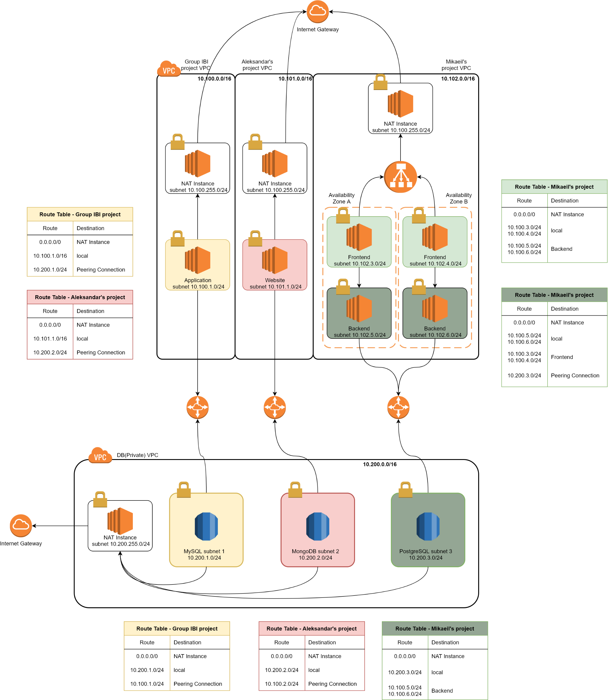

Slide 4
Project work and communication w/ other teams
Mikaeil’s project
IBI team project
Aleksandr’s project

Slide 5
Project vision
Terraform Automation
ECS + Docker to host websites
Ansible playbooks for Docker deployment
Full configuration of Route 53
User Manuals

Slide 6
Thank you for your attention ☺

